Slide 1


Identifying Conflicts: Particular Matters of General Applicability
David Maggi, Department of Commerce ADAEO
Francisco Ruben, National Science Foundation ADAEO
Kim Sikora Panza, Office of Govt Ethics Asst. Counsel

Slide 2



Particular Matters of General Applicability

Slide 3
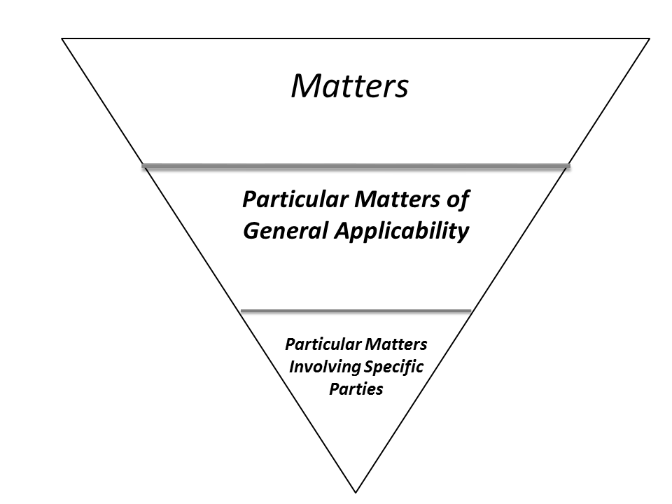
TYPES OF “MATTERS”
Matters
Particular Matters
of General Applicability
Particular Matters
Involving Specific
Parties

Slide 4
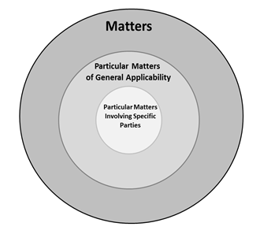
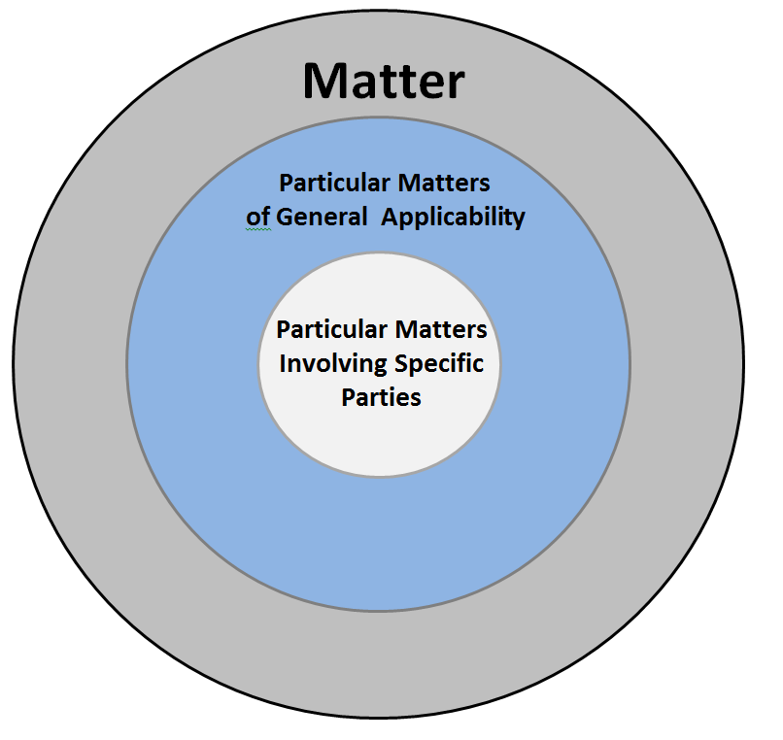
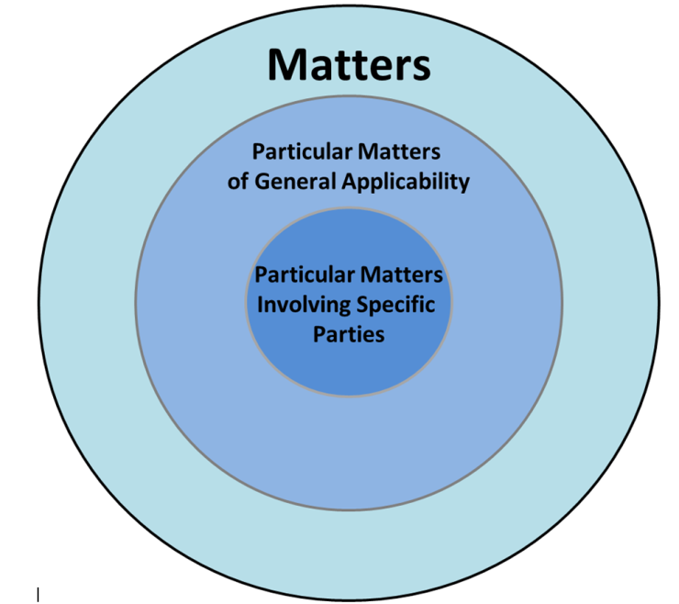
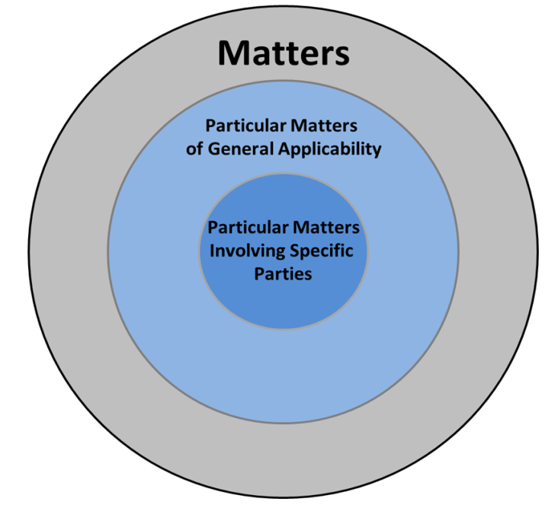
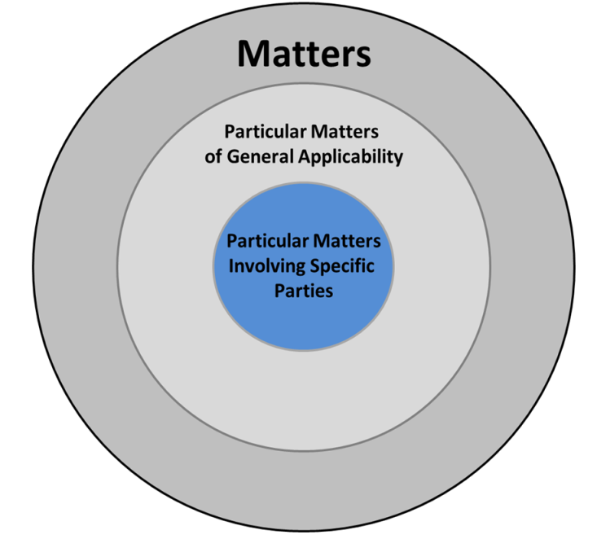
DEFINITIONS
Matters – Very broad; focus on a large
large and diverse group
Particular Matters
    Particular Matters of General Applicability -Narrower matters that are focused on a discrete and identifiable class
    Particular Matters Involving Specific Parties - A very limited group of identified parties is involved in the matter

Slide 5
LAWS IN WHICH IDENTIFYING TYPE OF MATTER IS IMPORTANT
18 U.S.C. § 203
18 U.S.C. § 205
18 U.S.C. § 207
18 U.S.C. § 208
5 C.F.R. § 2635.502

Slide 6

Particular Matters of General Applicability
  Discrete and identifiable class
    Shared characteristics or traits, distinguishable from the general population
  The matter is focused

Slide 7

ANALYZING THE CLASS
How do you decide when a class is so large that it is no longer discrete and identifiable?
When is the class “just right” such that the matter is a particular matter?

Slide 8

Roadmap for Analysis
How broad or narrow is the focus of the matter? Is the matter directed to a group of individuals or entities?
Is the class that the matter focuses on discrete and identifiable from the general population?
Does the matter have a distinct impact on a class that is separate from the impact of the
matter on the general population?

Slide 9

ASPIRIN EXAMPLE

Slide 10

ASPIRIN EXAMPLE
Don’t conflate the “particular matter” and “direct and predictable” analyses
Breaking up matters is generally not required
Prescription Coverage
Hospital Reimbursement Rates
Clinical Standards
Health Care Legislation

Slide 11

PARTICULAR MATTERS OUTSIDE 208
OLC opinion on 18 U.S.C. § 205
AUSAs were a discrete and identifiable class by “virtue of their employing agency, their profession and their position”

Slide 12


TRANSITIONS
The characterization of an activity as a “particular matter of general applicability” may change over time
Boundaries can be fluid and there
are no bright lines
Into the Particular Matter Involving Specific Parties bowl I go!

Slide 13

REAL WORLD EXAMPLES
Identifying “Particular Matters of General Applicability” and distinguishing them from other matters can be difficult

Slide 14

EDUCATING EMPLOYEES ON PARTICULAR MATTERS OF GENERAL APPLICABILITY
Use “Plain English”
Avoid jargon
Give examples
Simplify as appropriate

Slide 15


